Slide 1

UNSUPERVISED LEARNING

Slide 2
ROAD MAP
Introduction to unsupervised learning | ------------- | Clustering | ------------- | K-means algorithm

Slide 3
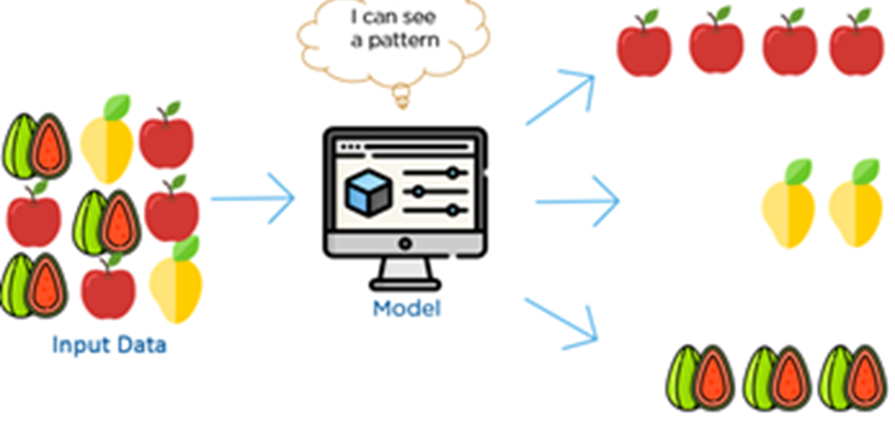

Slide 4
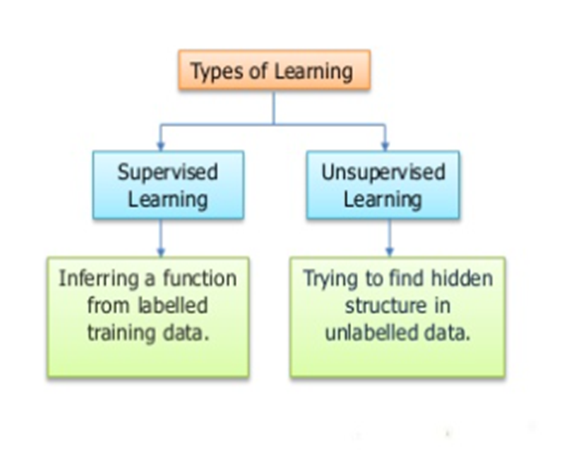

Slide 5
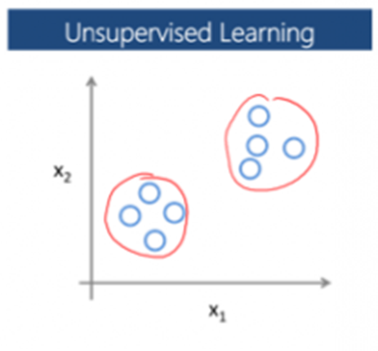

Slide 6
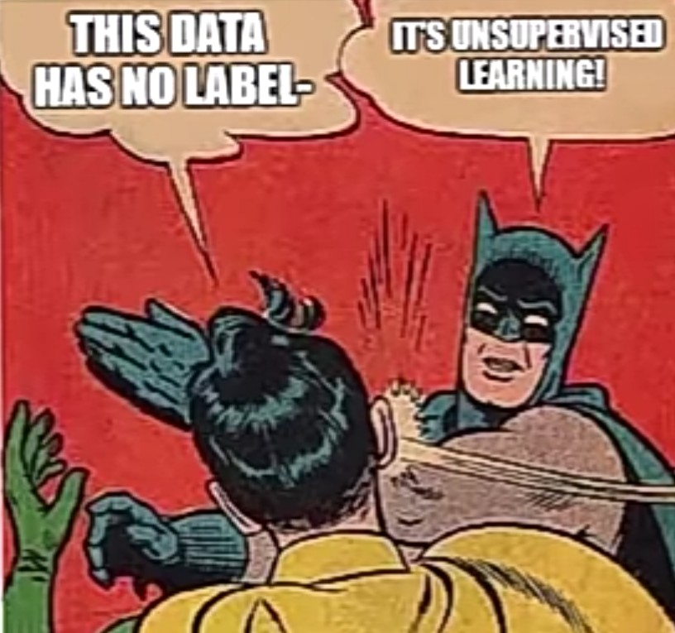

Slide 7
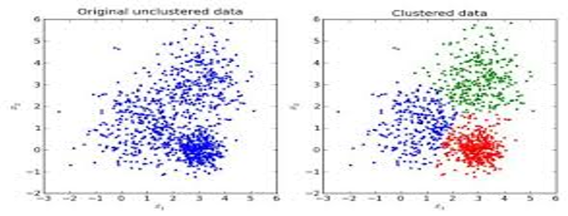
Clustering
Clustering is the process of grouping similar entities together. The goal of this unsupervised machine learning technique is to find similarities in the data point and group similar data points together.
Notes:
The 3 magic words for clustering is - Grouping Similar Entities!!!
When you think of unsupervised learning you instantly think about clustering its that synonymus so this is the backbone of USL.
Market segmentation. Many companies have huge databases of customer information. So, can you look at this customer data set and automatically discover market segments and automatically group your customers into different market segments so that you can automatically and more efficiently sell or market your different market segments together? Again, this is Unsupervised Learning because we have all this customer data, but we don't know in advance what are the market segments and for the customers...

Slide 8
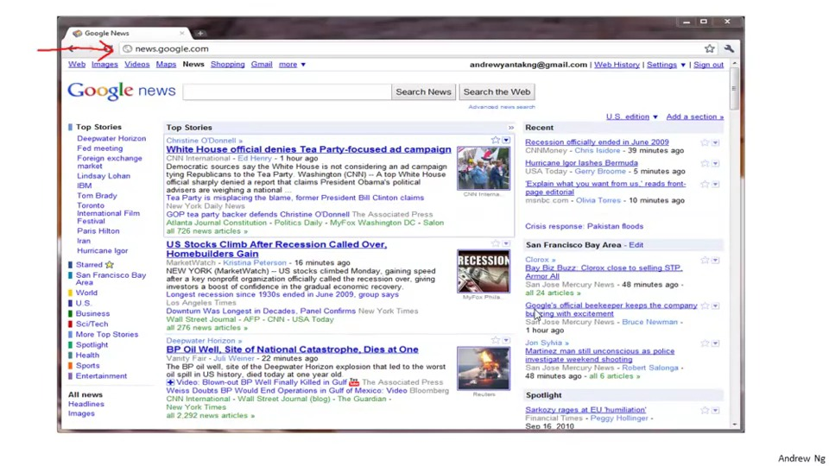
Clustering IRL!
Notes:
So this is what you would see if you checked out google news ,What Google News does is everyday it goes and looks at tens of thousands or hundreds of thousands of new articles on the web and it groups them into cohesive news stories.
For example lets take a look at this BP OIL well situation

Slide 9
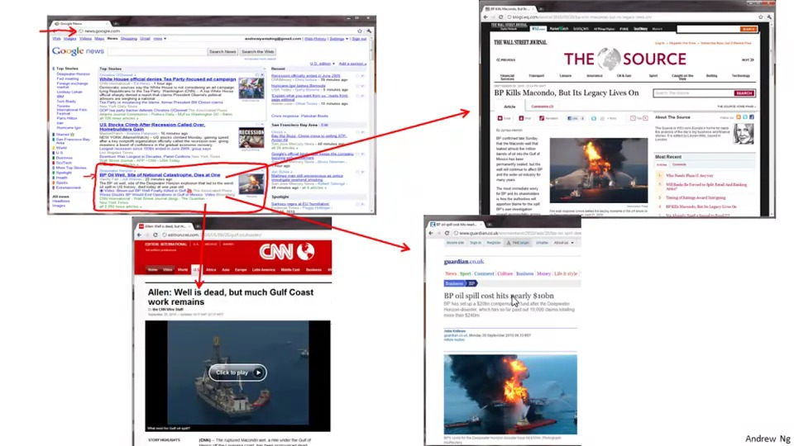
Notes:
If you click on one of the url’s
A wall street journal article comes about it
If you click on another url there is a CNN story about an oil well
And if another there is a story by uk gaurdian
So what google news has done is that it has looked for 100’s of news articlews about that 1 topic and clustered them together.

Slide 10
K-Means algorithm
The goal of this algorithm is to find groups in the data, with the number of groups represented by the variable K. The algorithm works iteratively to assign each data point to one of K groups based on the features that are provided.
Notes:
In a clustering algorithm we are given unlabeded datasets and we would like the algorithm automatically group the data into coherent clusters

Slide 11
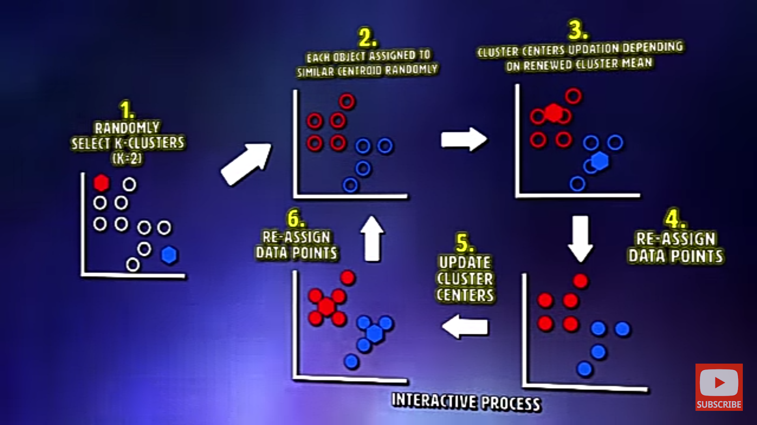
Notes:
1st step-randomly initialize 2 points called the cluster centroids
K means is an interative algorithm and it does 2 things- first is a cluster assignment step and then is move centroid step
Basically is goes through each of these points and assigns them to either of the cluster centroids seeing which one is closer to a certain centriod and that is cluster assignment step
And next what we are going to do is the move centroid step, taking the 2 centriods and moving them to the average of like the red clustrer points and blue cluster points.
As you can see the red centriod moves a bit more towards the red points and same goes with blue centriod
And again we do the cluster assignment step and this process iterates until the cluster centriods dont really move and proper segregated clusters are made.

Slide 12
Think of these as the people who show up at a party and soon become the
centres of attention because they’re so magnetic.
If there’s just one of them, everyone will gather around
If there are lots, many smaller centres of activity will form

Slide 13
https://www.naftaliharris.com/blog/visualizing-k-means-clustering/

Slide 14
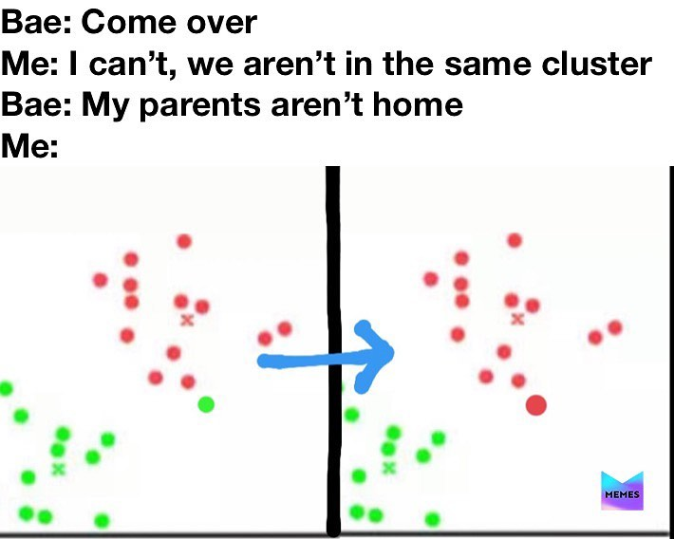

Slide 15
Thank you!

